Slide 1
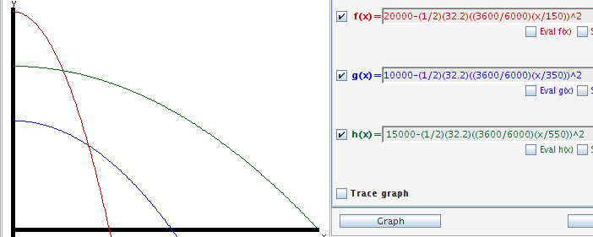
After it is released from an aircraft, a GBU-12, follows a ballistic trajectory prior to the acquisition of a laser signal and initiation of guidance. Assume the bomb experiences zero acceleration in the horizontal direction and only acceleration due to gravity in the vertical direction (assume no drag and wind). For each of the scenarios described below 1) develop an equation to describe ballistic trajectory along the horizontal and vertical axes, 2) calculate the time of fall, 3) calculate the distance each GBU will travel after release, and 4) calculate the impact angles (degrees). Plot the three trajectories on a single xy-graph for comparison. Scenario 1: An MQ-9 flying 150 KTAS at 25,000 MSL drops a GBU-12 to hit a target at 5,000 MSL Scenario 2: An A-10 flying 350 KTAS at 15,000 MSL drops a GBU-12 to hit a target at 5,000 MSL Scenario 3: An F-16 flying 550 KTAS at 20,000 MSL drops a GBU-12 to hit a target at 5,000 MSL
Notes:
20000-(1/2)(32.2)((3600/6000)(x/150))^2
10000-(1/2)(32.2)((3600/6000)(x/350))^2
15000-(1/2)(32.2)((3600/6000)(x/550))^2

Slide 2
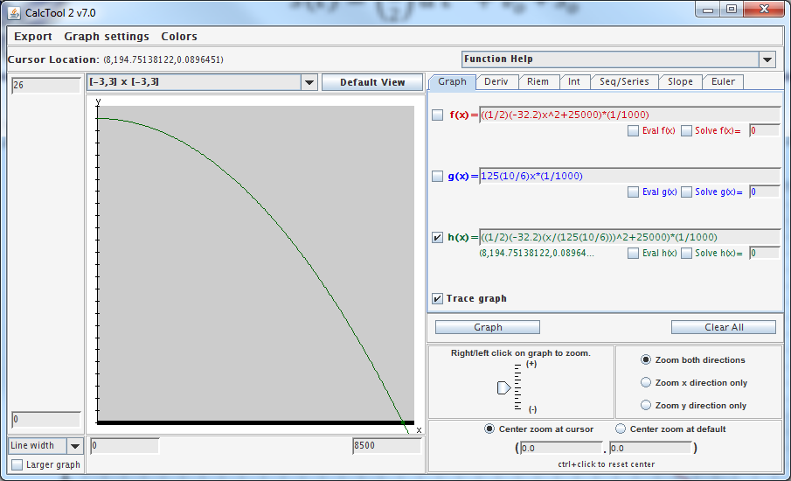
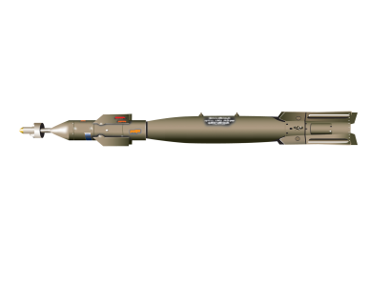





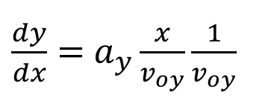


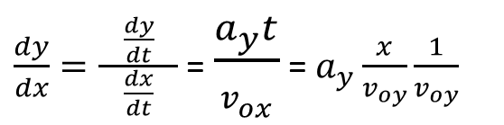



$s\left(t\right)=\left(\frac{1}{2}\right)a t^{2}+v_{o}$ + $s_{o}$
$y\left(t\right)=\left(\frac{1}{2}\right)a_{y}t^{2}+v_{oy}$t + $s_{oy}$
$x\left(t\right)=\left(\frac{1}{2}\right)a_{x}t^{2}+v_{ox}$t + $s_{ox}$
$a_{y}=−32.2 ft/s^{2}, { v}_{oy}$ = 0, ${ s}_{ox}$ = 20k
$a_{x}=0, { v}_{ox}$ = 150kts, ${ s}_{ox}$ = 0
$x\left(t\right)=v_{ox}$(6000ft/nm)(hr/3600s)t
$x\left(t\right)={(\frac{5}{3})v}_{ox}$t
$\frac{dy}{dx}=$ $a_{y}{\frac{x}{v_{oy}}\frac{1}{v_{oy}}}^{}$
t = x($\frac{3}{\text{5}v_{ox}}$)
$y\left(x\right)=\left(\frac{1}{2}\right)(−32.2){(\text{x}\text{(}\frac{3}{\text{5}v_{ox}}\text{)})}^{2}$ + $20000$
Ft (1000’s)
$\frac{dy}{dx}=\frac{ \frac{dy}{dt} }{\frac{dx}{dt}}$ = $\frac{a_{y}t}{v_{ox}}$ = $a_{y}{\frac{x}{v_{oy}}\frac{1}{v_{oy}}}^{}$
distance (ft)
Notes:
Ay = (-32.2 ft/s^2)
Vx = 125kts(10/6) (1nm/hr)(hrt/3600sec)(6000ft/nm) = (10/6)ft/s
The GBU-12 Paveway II laser-guided bomb is an American aerial bomb, based on the Mk 82 500-pound general-purpose bomb, but with the addition of a nose-mounted laser seeker and fins for guidance. A member of the Paveway series of weapons, Paveway II entered into service c. 1976. It is currently in service withU.S. Air Force, US Navy, US Marine Corps, Royal Canadian Air Force,Colombian Air Force, and various NATO air forces.
GBU-12 bombs (along with the balance of the Paveway series) are produced bydefense contractors Lockheed Martin and Raytheon. Raytheon began production after purchasing the product line from Texas Instruments. Lockheed Martin was awarded a contract to compete with Raytheon when there was a break in production caused by transferring manufacturing out of Texas. "Paveway II" refers specifically to the guidance kit, rather than to the weapon itself. See also GBU-16 Paveway II, where the same guidance unit is fitted to aMk 83 1,000-lb bomb.
The US Department of Defense has upgraded GBU-12 production versions to include GPSguidance modes. Lockheed Martin is the sole source for US Navy purchases of this version. Raytheon sells upgraded GBU-12s to the US Government and other nations. Raytheon production of the GBU-12 is centered in Arizona, Texas, and New Mexico. Lockheed Martin production is centered in Pennsylvania.
Laser-guided bombs are often labeled "smart bombs" because they are able to follow a non-ballistic trajectory when laser designation of the intended target is undertaken. According to Raytheon's fact sheet for the Paveway 2, 99 deliveries of guided munitions will yield a circular error probable (CEP) of only 3.6 feet, versus a CEP of 310 feet for 99 unguided bombsdropped under similar conditions.
Paveway II laser-guided bombs use what is known as "bang bang" guidance. This means the bomb's fins deflect fully, rather than proportionally when it is attempting to guide to the laser spot. For example, if it sees the laser spot and determines that it should make a change it deflects its fins until it has over-corrected and then it deflects back the opposite direction, creating a sinusoidal type of flight path. This type of guidance may be less efficient at times.

Slide 4
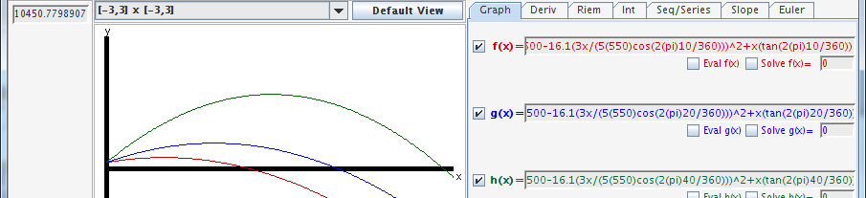
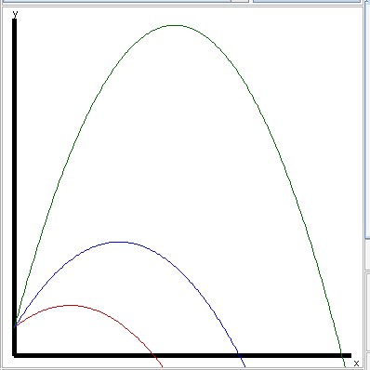
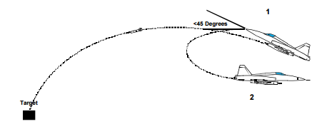
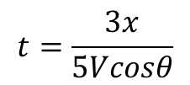
JDAMs allow improved accuracy when released by means of a “loft” or “toss” delivery. Assume a JDAM is released using a loft delivery angle of 10, 20 and 40 degrees above the horizon from 500 feet AGL* and 550 KTAS. For each of the three loft angles, decompose the velocity vector of the JDAM into its vertical and horizontal components to plot the three profiles on a single graph. Use the graph to determine the range and time of flight for each of the three loft delivery angles. Assume no-wind and no-drag.
1:1 plot
6000’
V
V sinθ
$$t=\frac{3x}{5Vcosθ}$$
θ
V cosθ
27000’
Notes:
Y = 500-16.1(3x/(5(550)cos(2(pi)10/360)))^2+x(tan(2(pi)10/360)
Y = 500-16.1(3x/(5(550)cos(2(pi)20/360)))^2+x(tan(2(pi)20/360)
Y = 500-16.1(3x/(5(550)cos(2(pi)40/360)))^2+x(tan(2(pi)40/360)
Makes sense? Sub’ing in 0 degrees, gives a range of 5109’. (550kts = 916.7fps. TOF = 5.6Ssec. 916.7 x 5.6 = 5133’)

Slide 6
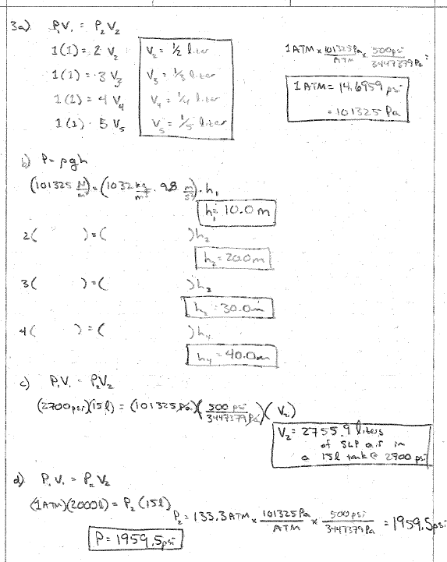
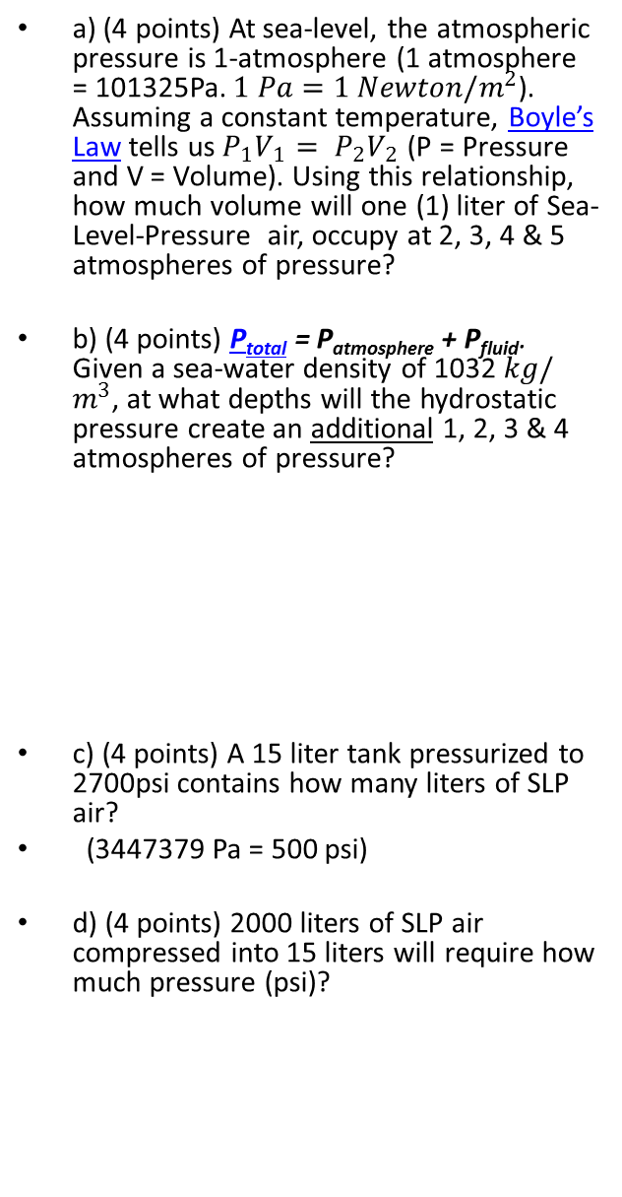
a) (4 points) At sea-level, the atmospheric pressure is 1-atmosphere (1 atmosphere = 101325Pa. $1 Pa=1 Newton/m^{2}$). Assuming a constant temperature, Boyle’s Law tells us $P_{1}V_{1}= P_{2}V_{2}$ (P = Pressure and V = Volume). Using this relationship, how much volume will one (1) liter of Sea-Level-Pressure air, occupy at 2, 3, 4 & 5 atmospheres of pressure?
b) (4 points) P_{total} = P_{atmosphere} + P_{fluid}. Given a sea-water density of 1032 $kg/m^{3}$, at what depths will the hydrostatic pressure create an additional 1, 2, 3 & 4 atmospheres of pressure?
c) (4 points) A 15 liter tank pressurized to 2700psi contains how many liters of SLP air?
(3447379 Pa = 500 psi)
d) (4 points) 2000 liters of SLP air compressed into 15 liters will require how much pressure (psi)?

Slide 7
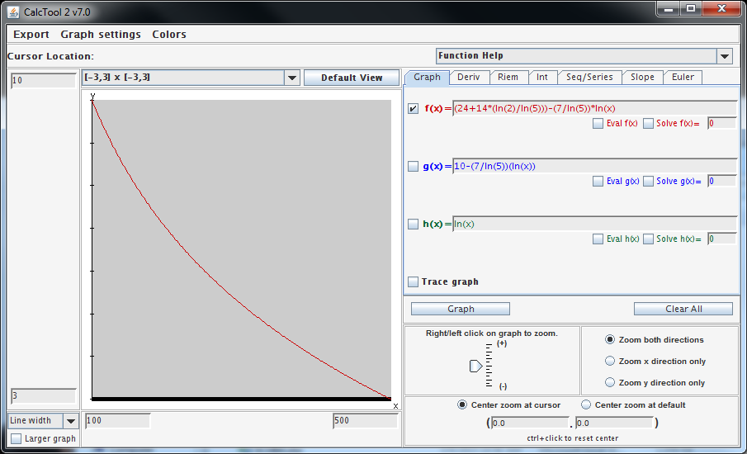
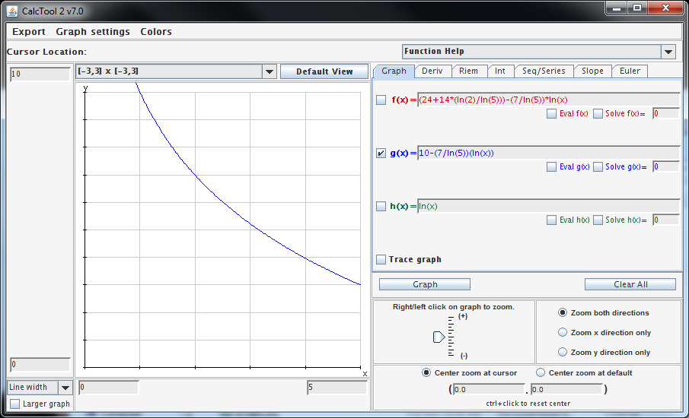
Upon reaching the depth of 32 m, securing the fuel rods will require moderate intensity exertion. To not exceed a respiration rate of 40bpm, the rate of force application (“dF/dt”) is directly proportional to the collective force (“= k F”) of the team-members’ 10-rep maximum bench press. Crews with a collective force of 100 lbs can complete the task in 10 minutes, while crews with a collective force of 500 lbs can complete the task in 3 minutes. Derive both t(F) and F(t).
Notes:
(24+14*(ln(2)/ln(5)))-(7/ln(5))*ln(x) plot on y-axis from 3-10, x-axis from 100-500
10-(7/ln(5))(ln(x)) plot on y-axis from 0-10, x-axis from 0-5

Slide 8
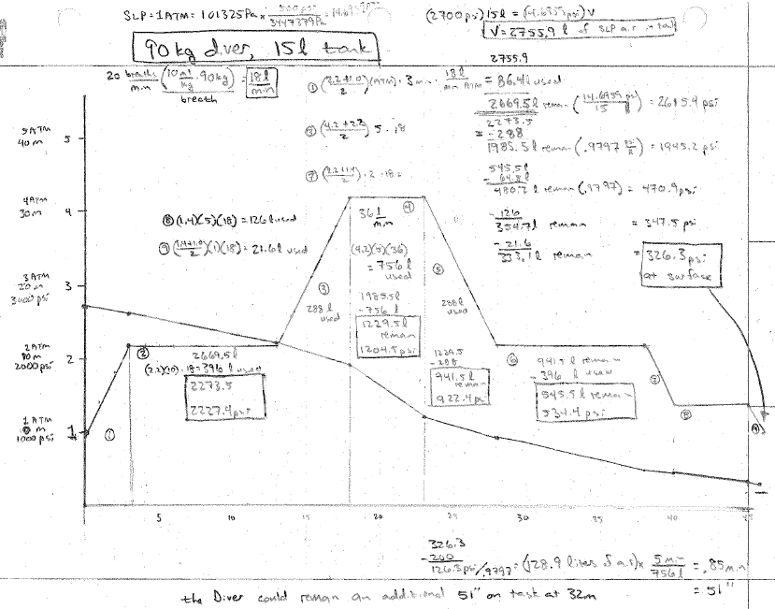

Slide 9
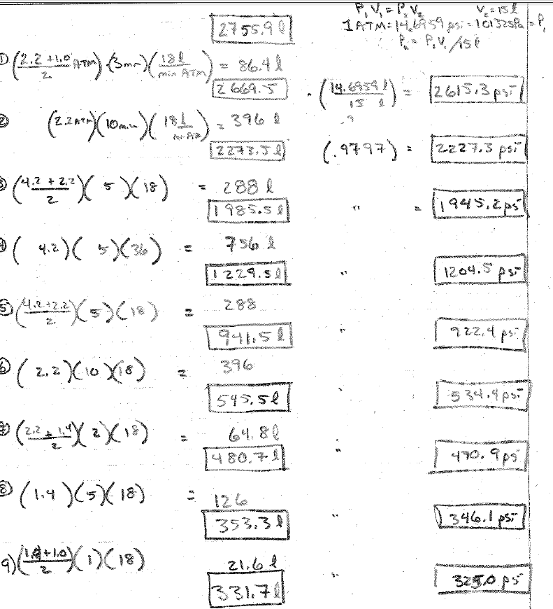
90kg diver 15liter tank
Density 1032kg/m^3
Up/Dn @ 4m/min

Slide 10
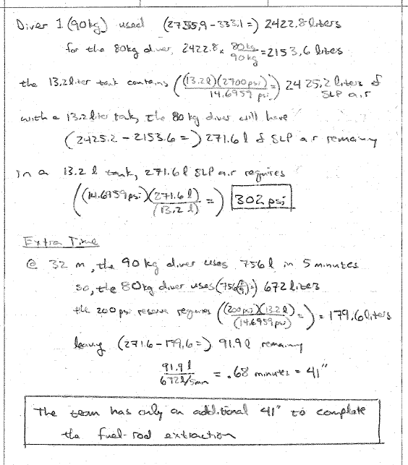

Slide 11
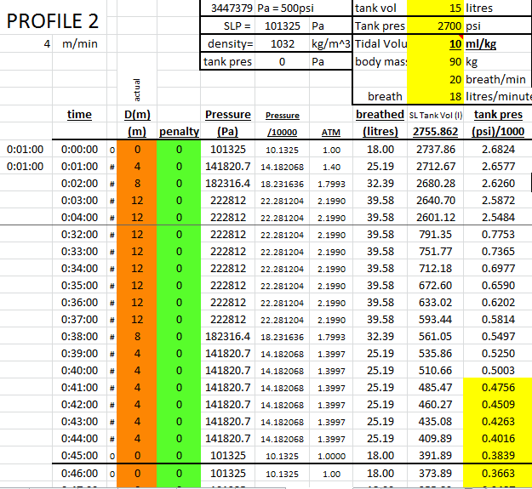
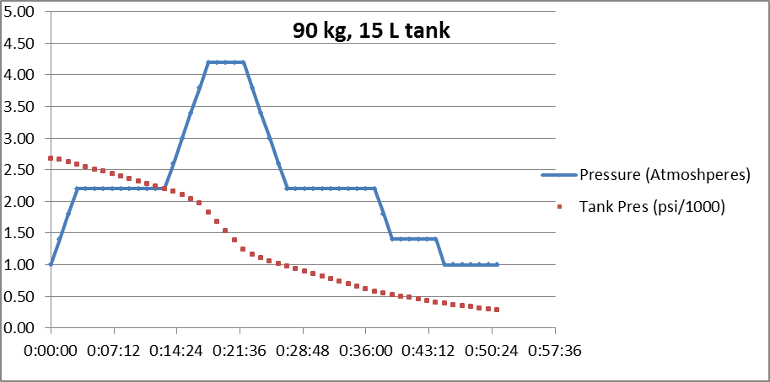
90kg diver 15liter tank
Notes:
this uses

Slide 12
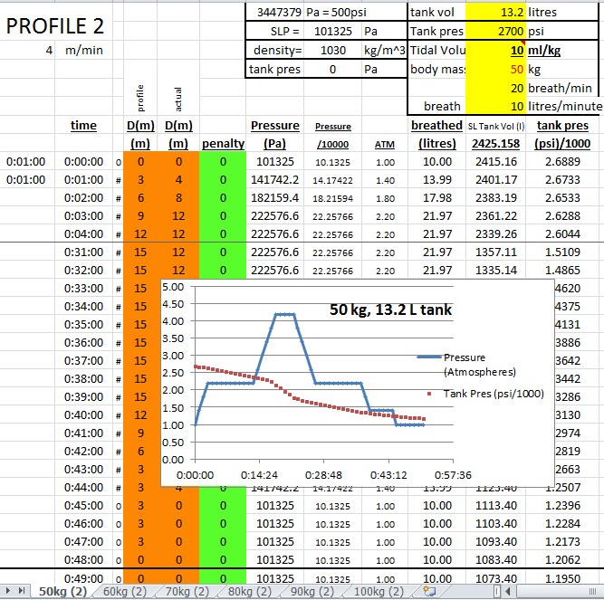

Slide 13
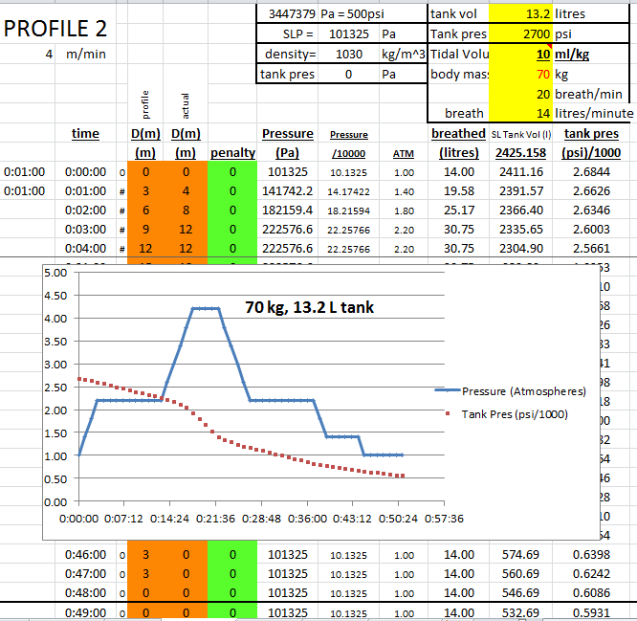

Slide 14
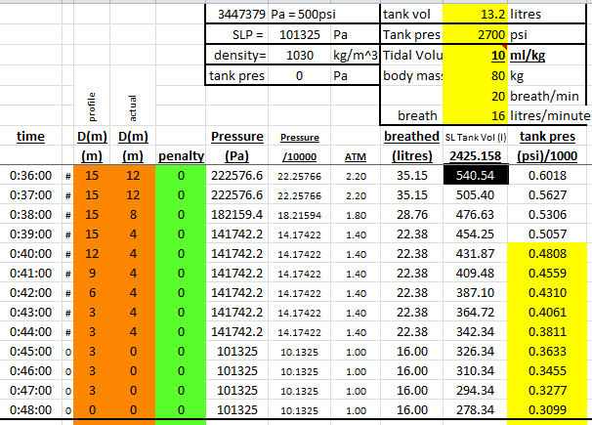
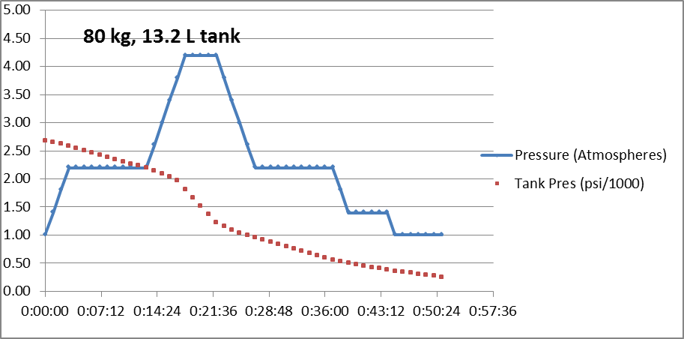

Slide 15
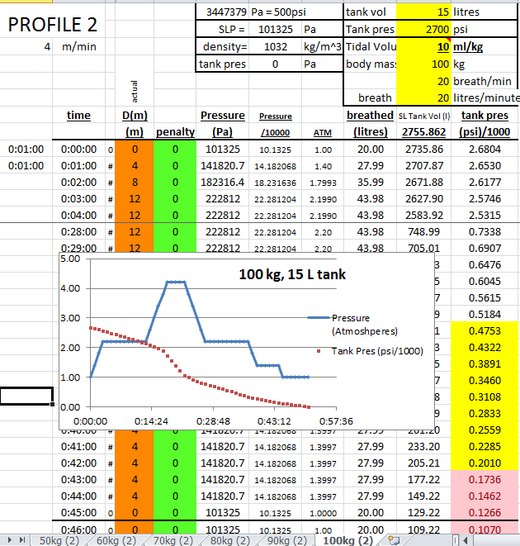

Slide 16
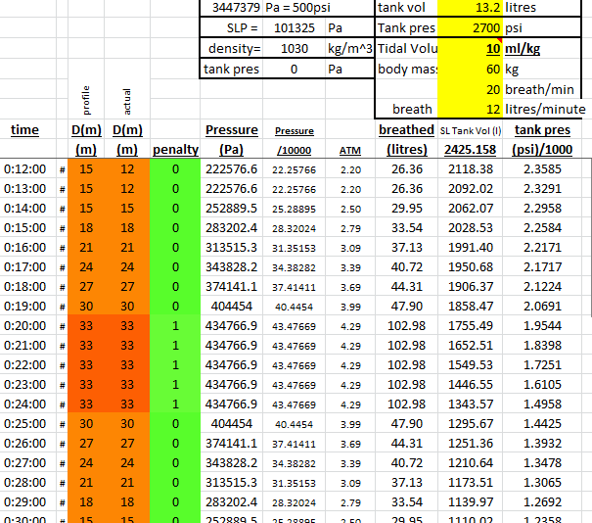
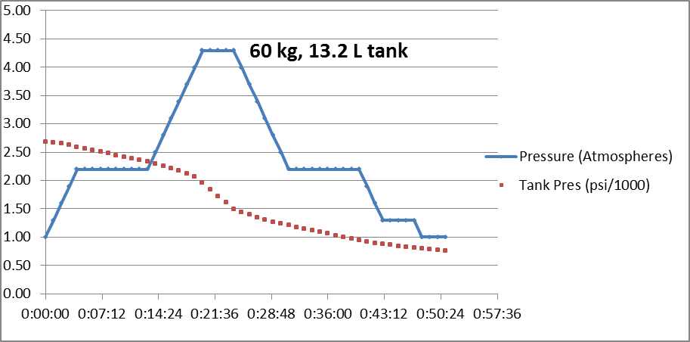
60kg diver 13.2liter tank

